Slide 1
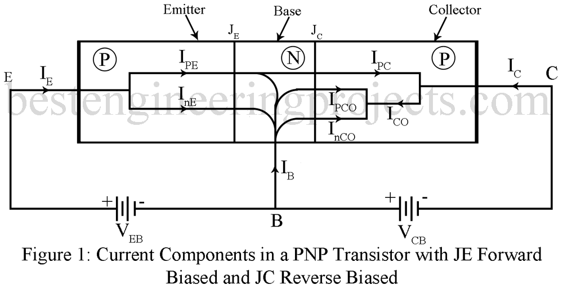




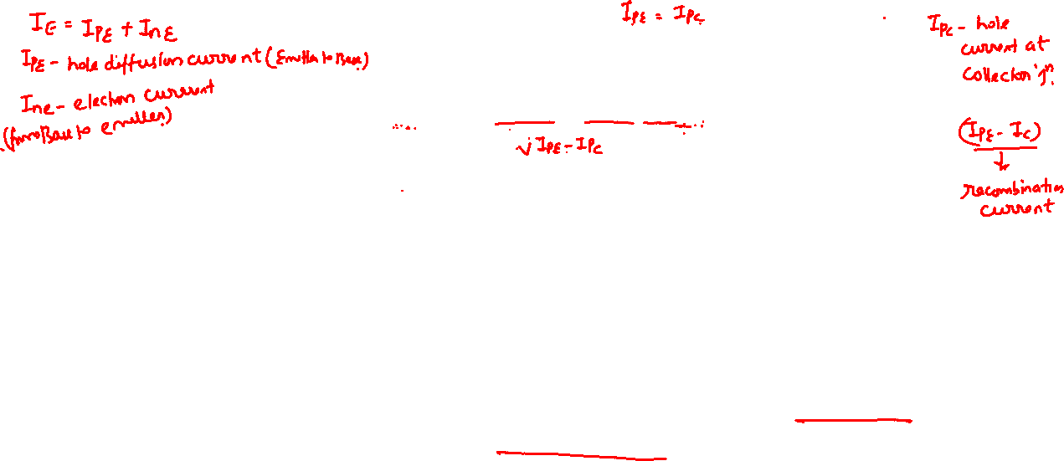
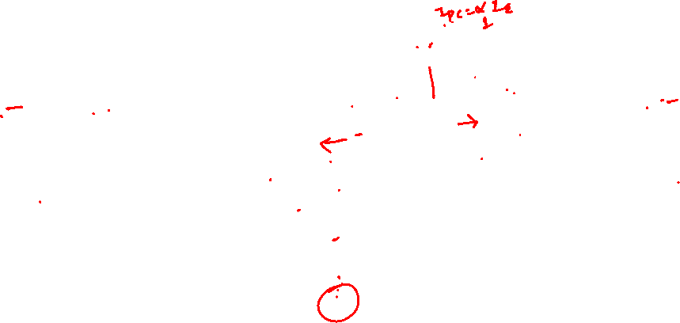
Bipolar Junction Transistor (BJT)

Slide 2
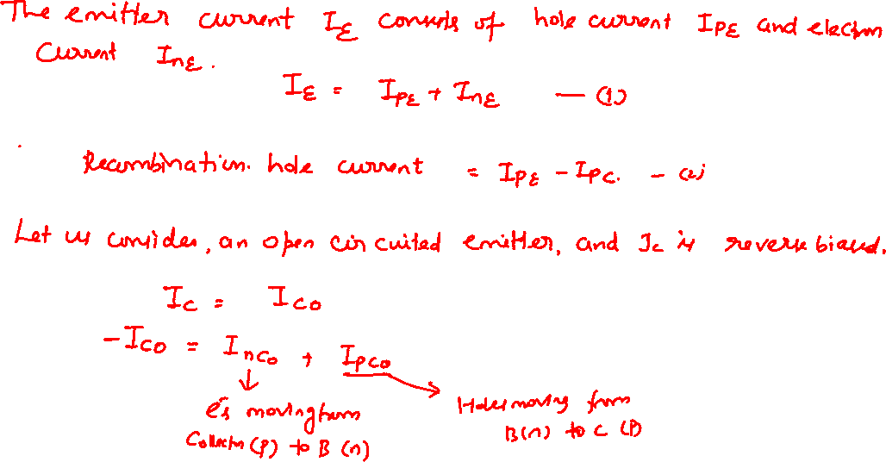
Bipolar Junction Transistor (BJT)

Slide 3
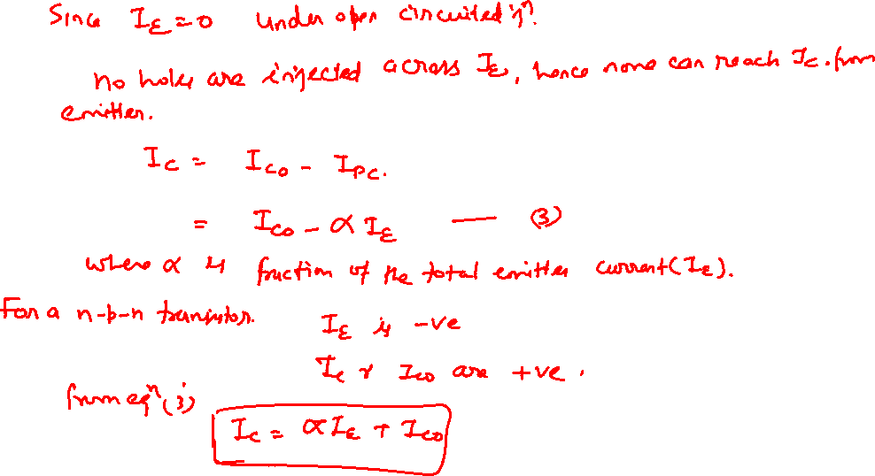

Bipolar Junction Transistor (BJT)

Slide 4
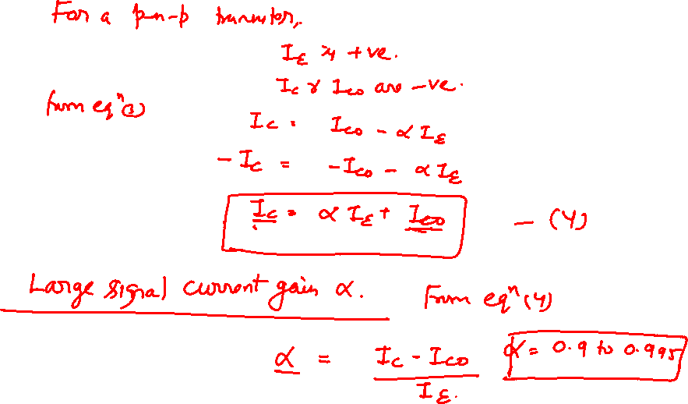
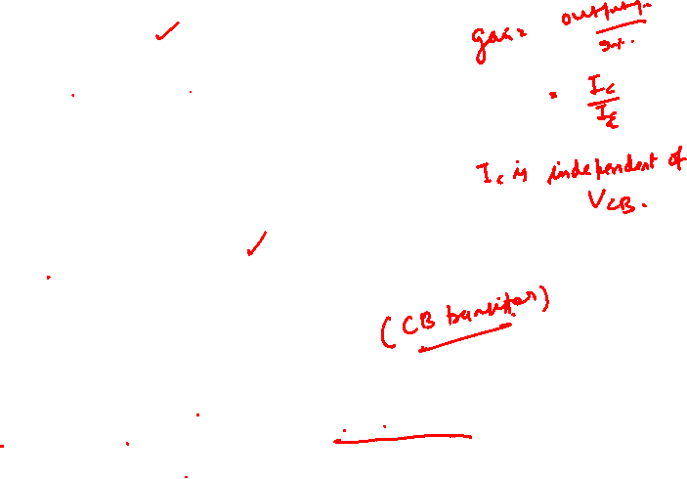
Bipolar Junction Transistor (BJT)

Slide 5

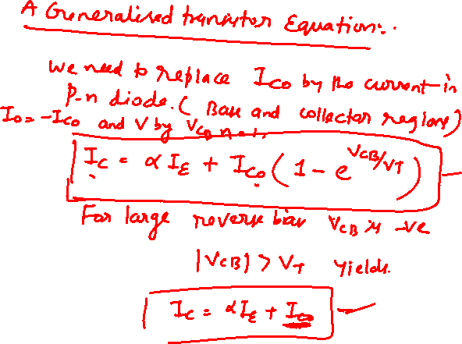
Bipolar Junction Transistor (BJT)

Slide 6
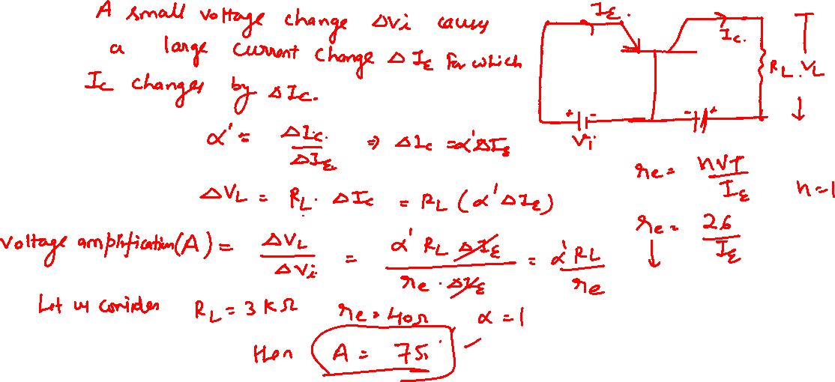

Transistor as an Amplifier

Slide 7
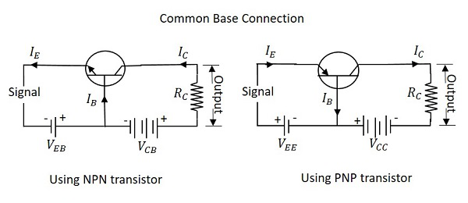
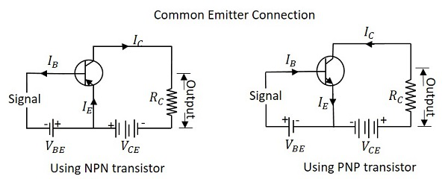
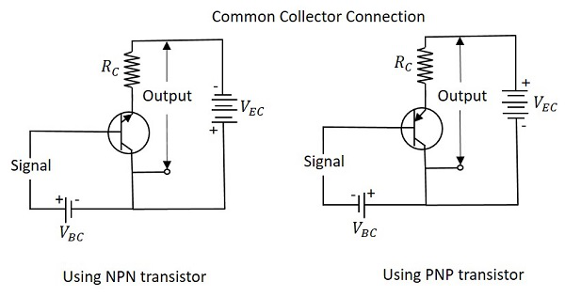

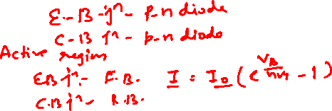
Different Configurations of BJT

Slide 8
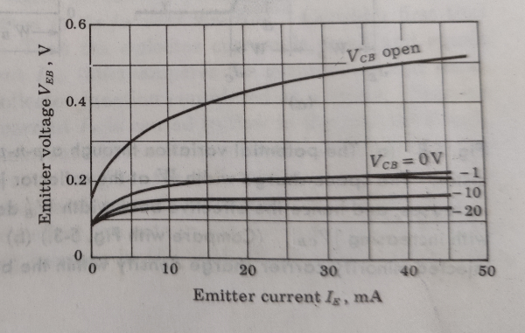
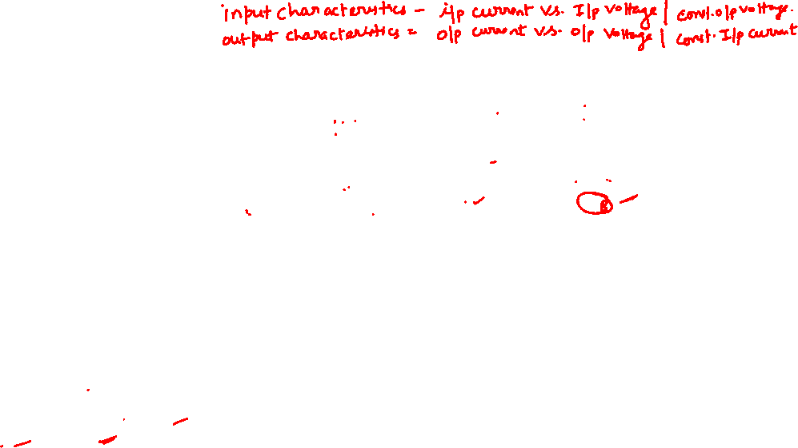
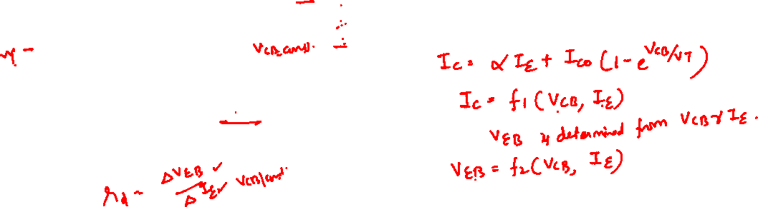
The Common Base (CB) Configuration
Common Base Input Characteristics
Fig. Common Base Input Characteristics of a typical p-n-p germanium transistor.

Slide 9
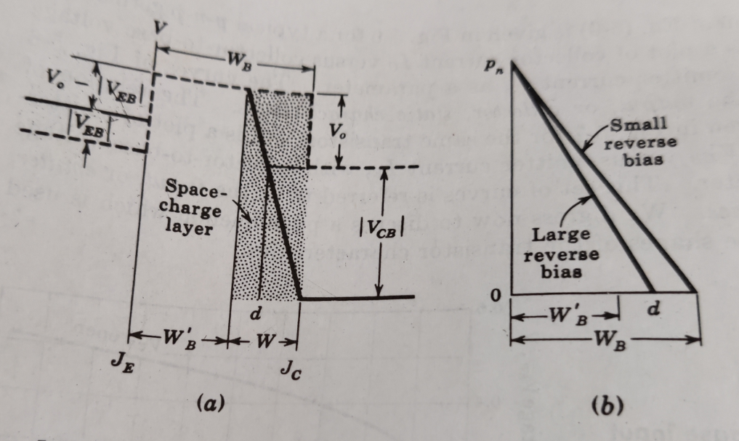
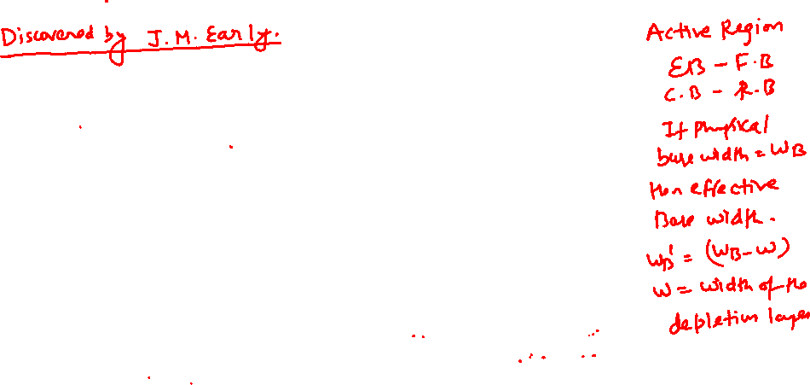
The Early Effect or Base Width Modulation

Slide 10
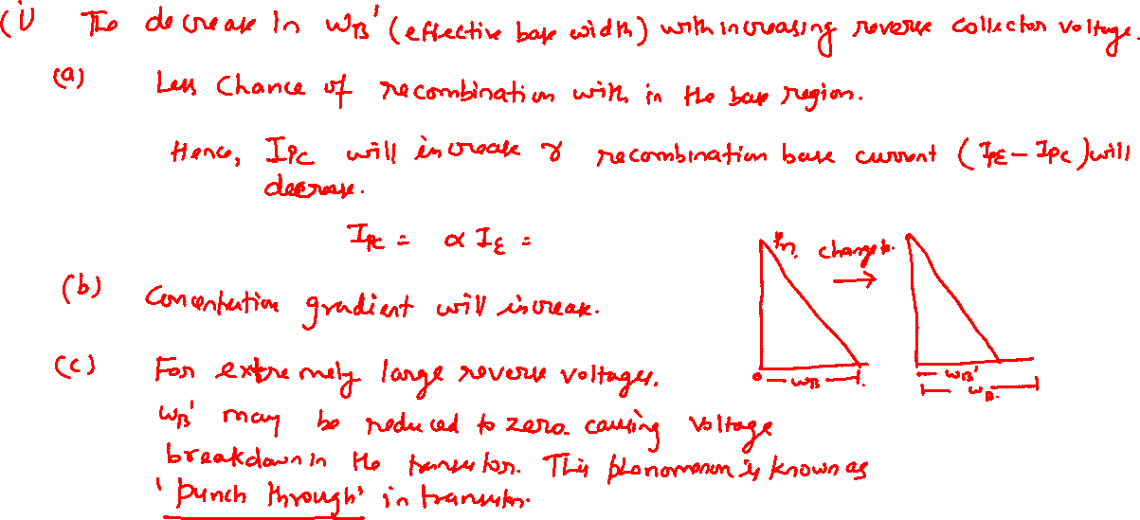


The Common Base (CB) Configuration

Slide 11
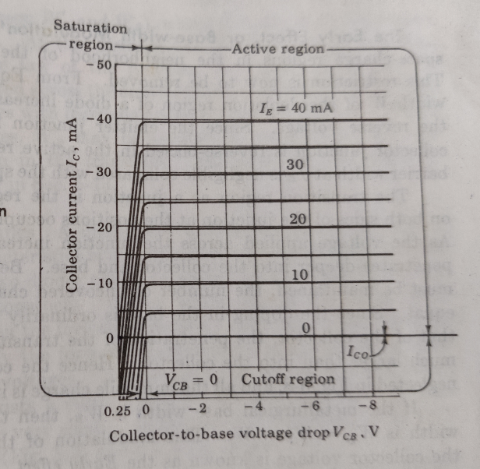
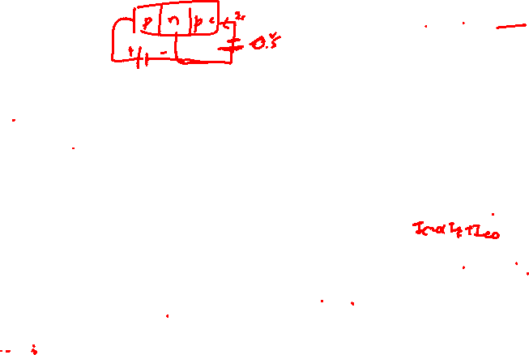

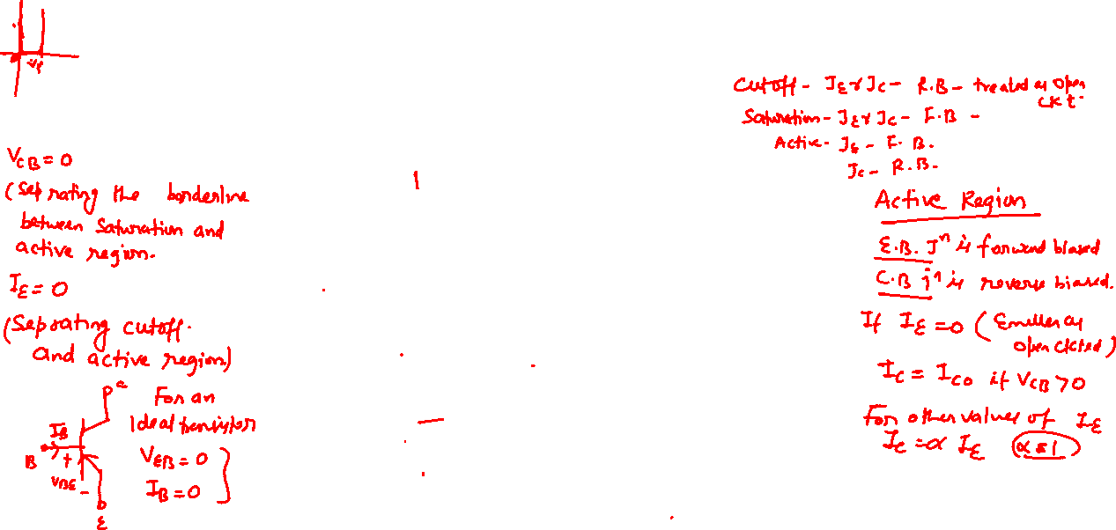
The Common Base (CB) Configuration
Common Base Output Characteristics
Fig. Common Base Output Characteristics of a typical p-n-p germanium transistor.

Slide 12

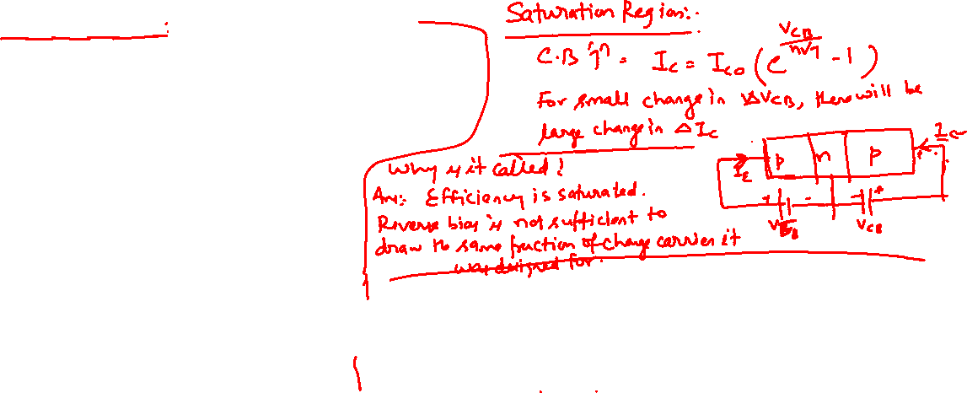
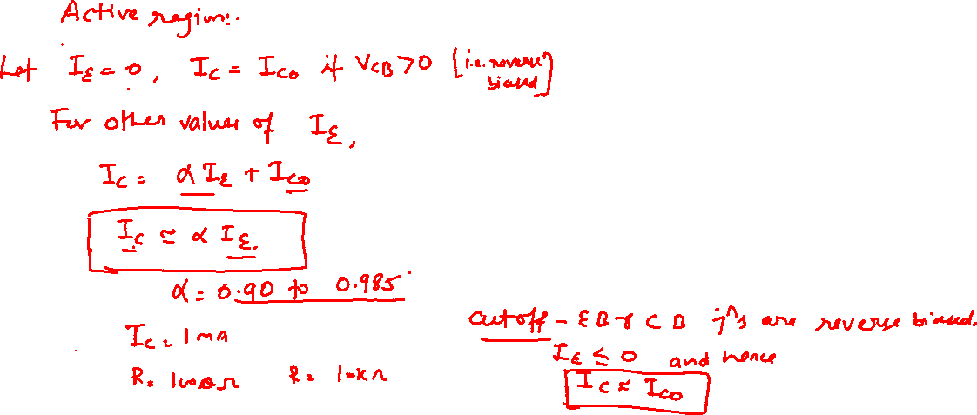
The Common Base (CB) Configuration

Slide 13
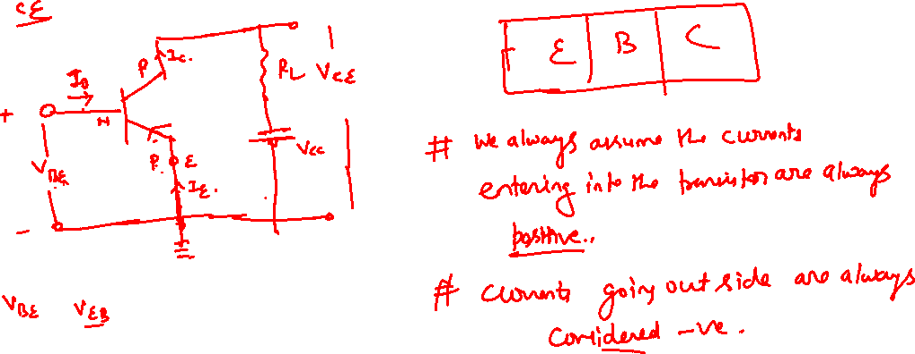
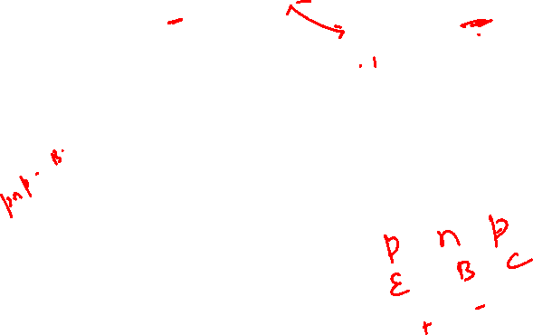
The Common Emitter (CE) Configuration

Slide 14
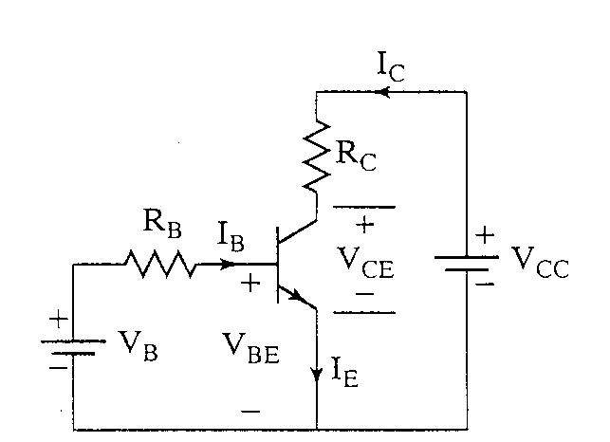
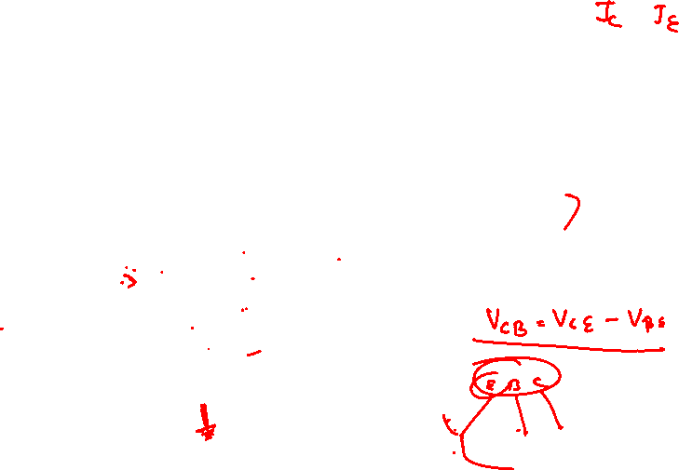
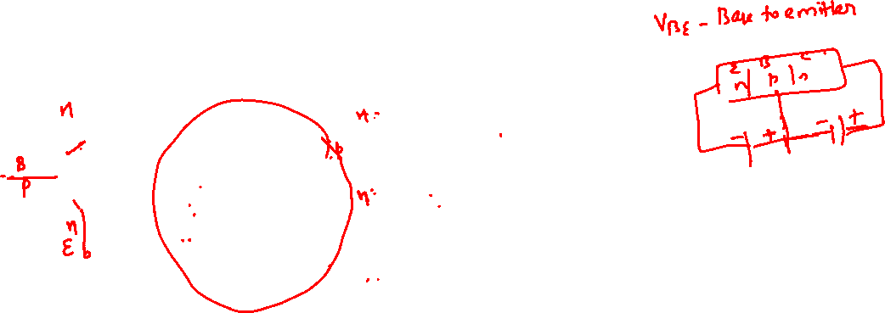
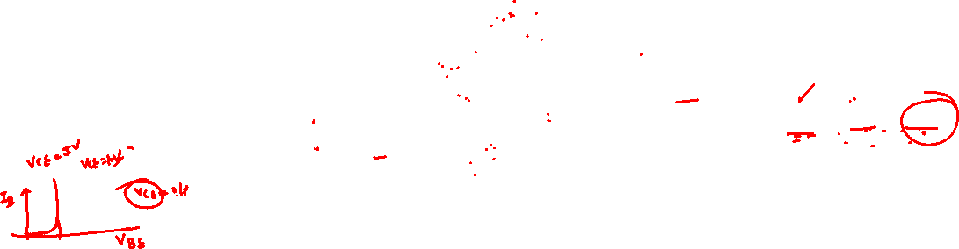
Common-Emitter NPN Transistor
The Common Emitter (CE) Configuration
Reverse bias the CBJ
Forward bias the BEJ

Slide 15
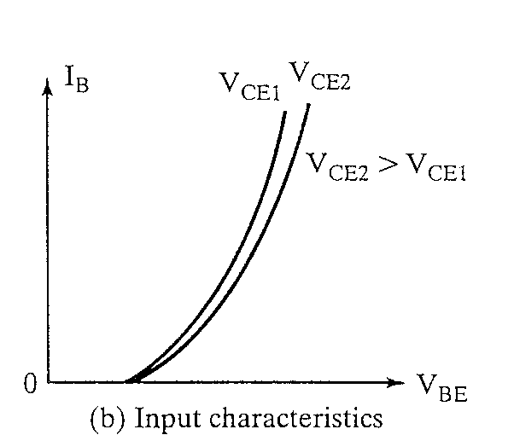

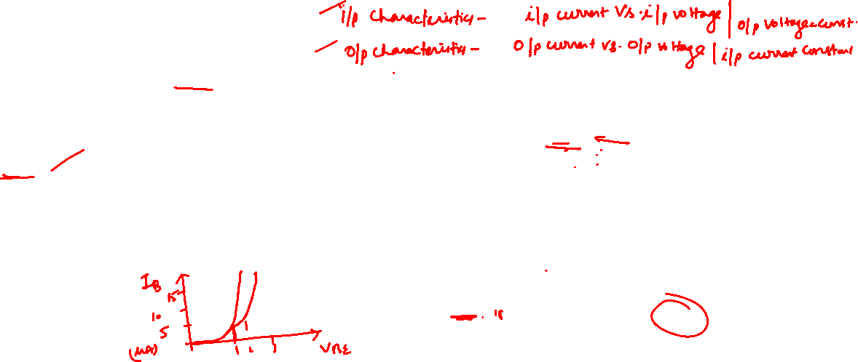
Input Characteristics
The Common Emitter (CE) Configuration
Plot I_{B} as f(V_{BE}, V_{CE})
As V_{CE} increases, more V_{BE} required to turn the BE on so that I_{B}>0.
Looks like a pn junction volt-ampere characteristic.

Slide 16
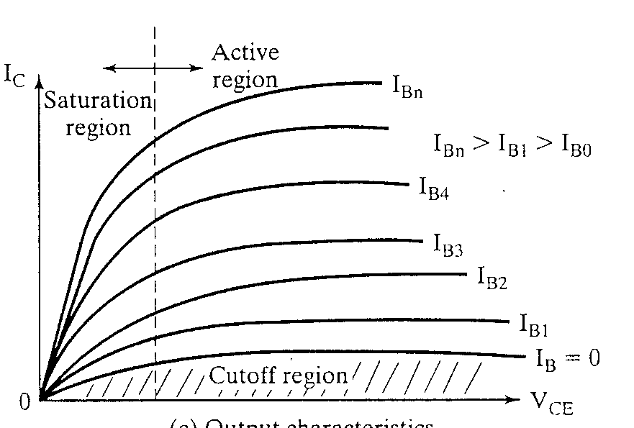
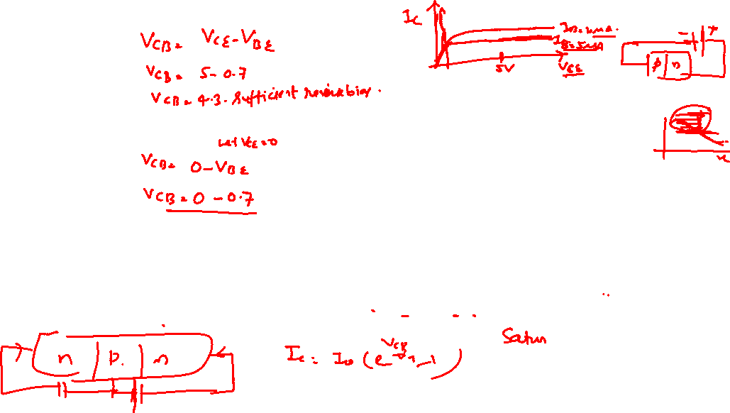

Output Characteristics
The Common Emitter (CE) Configuration
Plot I_{C} as f(V_{CE}, I_{B})
Cutoff region (off)
both BE and BC reverse biased
Active region
BE Forward biased
BC Reverse biased
Saturation region (on)
both BE and BC forward biased

Slide 17
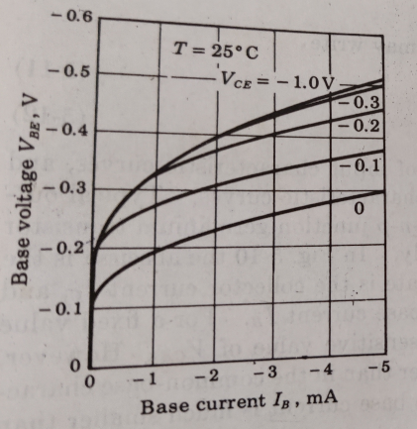
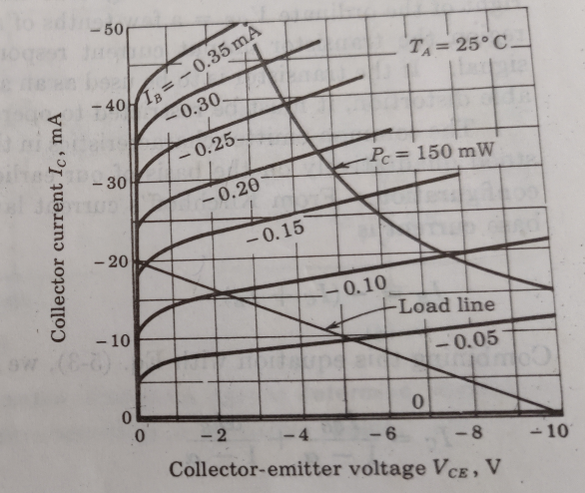
The Common Emitter (CE) Configuration
Fig. CE Input-Output Characteristics of a typical p-n-p germanium transistor.

Slide 18

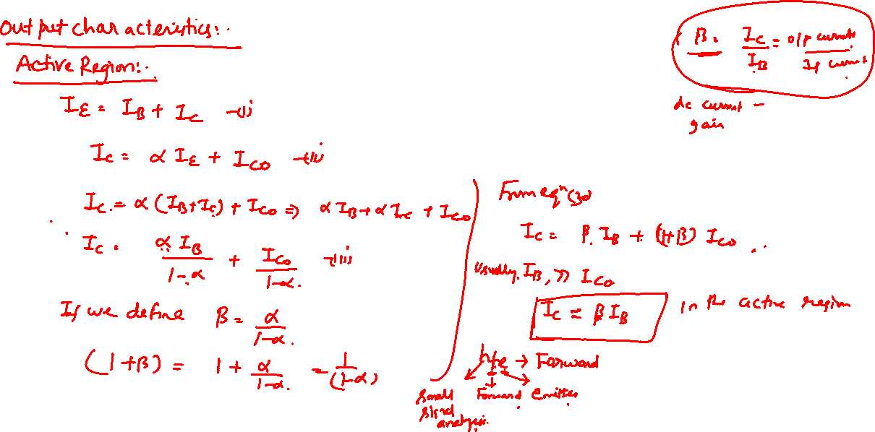
The Common Emitter (CE) Configuration

Slide 19
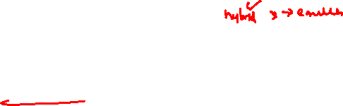

The Common Emitter (CE) Configuration
Current Gain:
α is the fraction of electrons that diffuse across the narrow Base region
1- α is the fraction of electrons that recombine with holes in the Base region to create base current
The current Gain is expressed in terms of the β (beta) of the transistor (often called h_{fe} by manufacturers).
β (beta) is Temperature and Voltage dependent.
It can vary a lot among transistors (common values for signal BJT: 20 - 200).

Slide 20
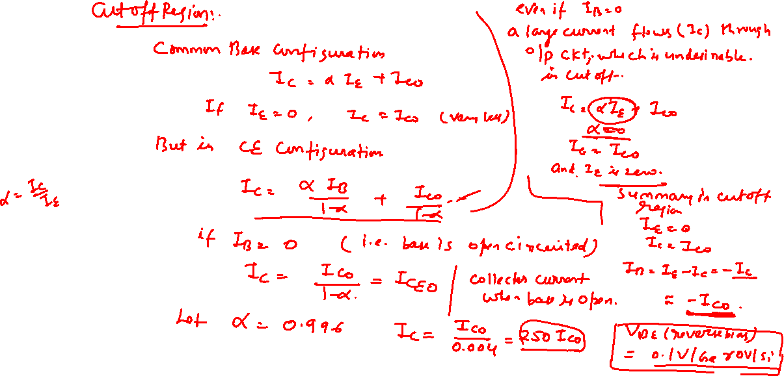

The Common Emitter (CE) Configuration

Slide 21

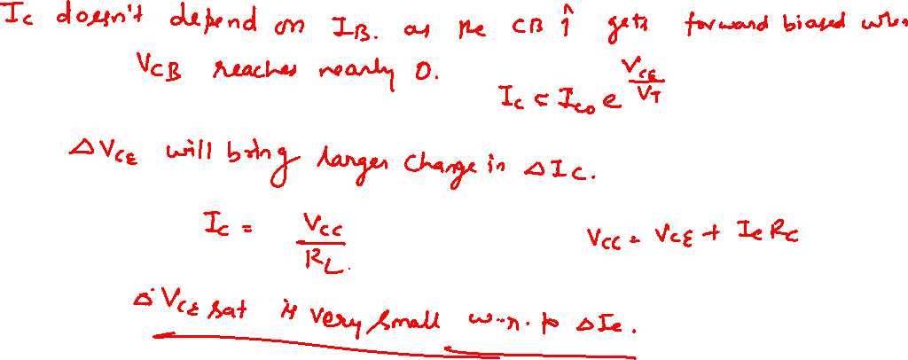
The Common Emitter (CE) Configuration

Slide 22
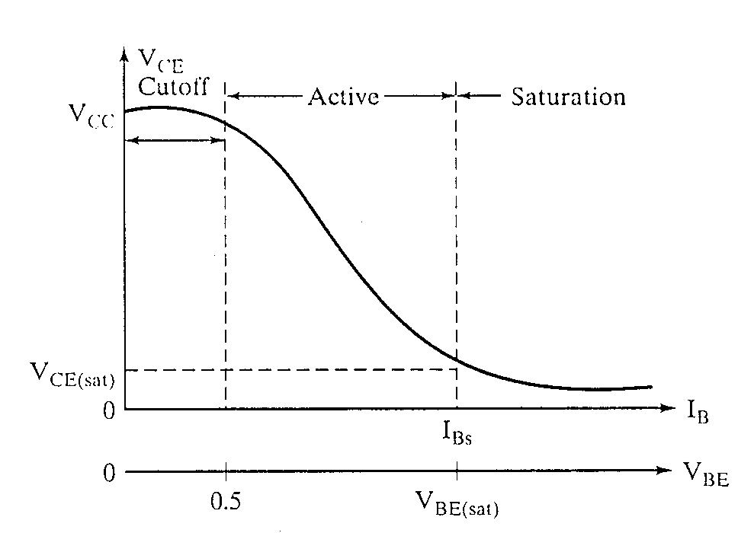
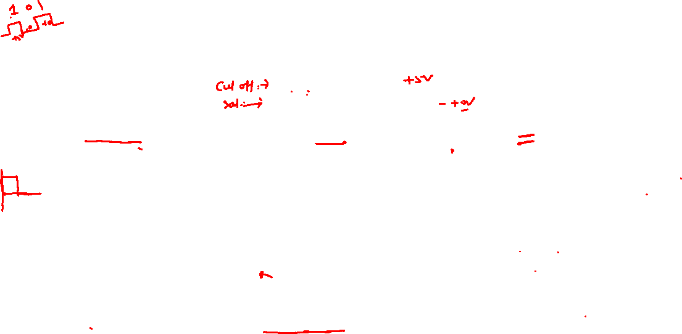
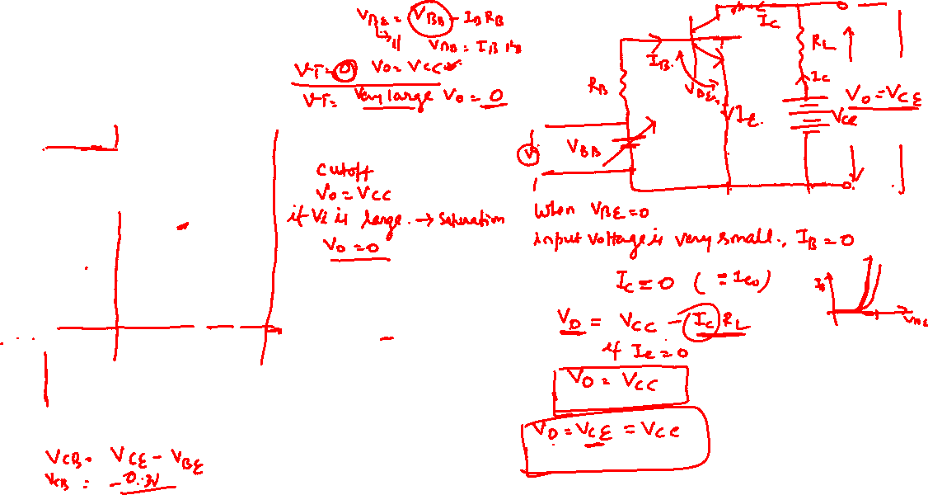
Transfer Characteristics
The Common Emitter (CE) Configuration

Slide 23
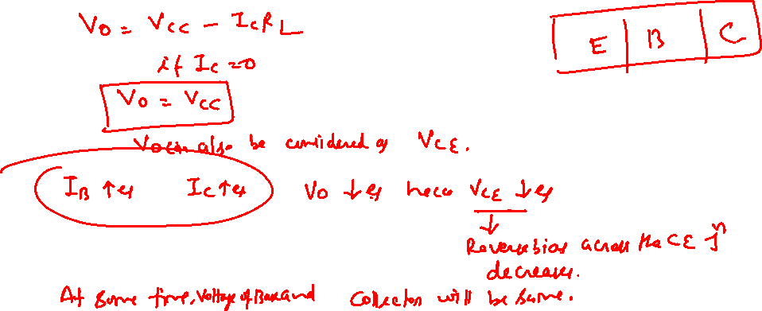
The Common Emitter (CE) Configuration

Slide 24
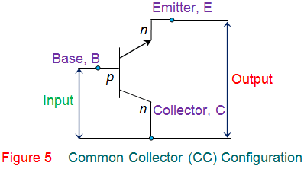
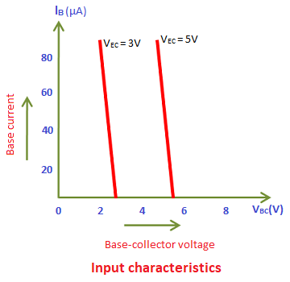
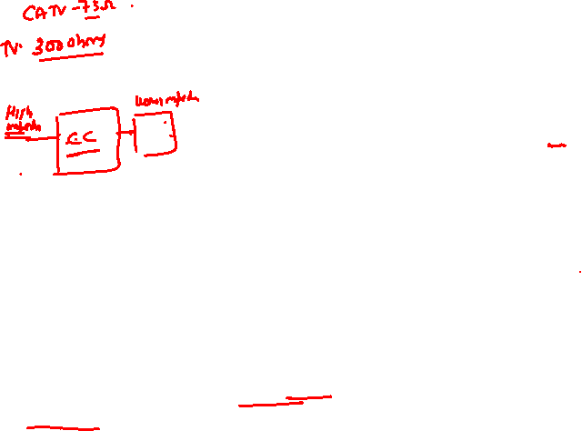
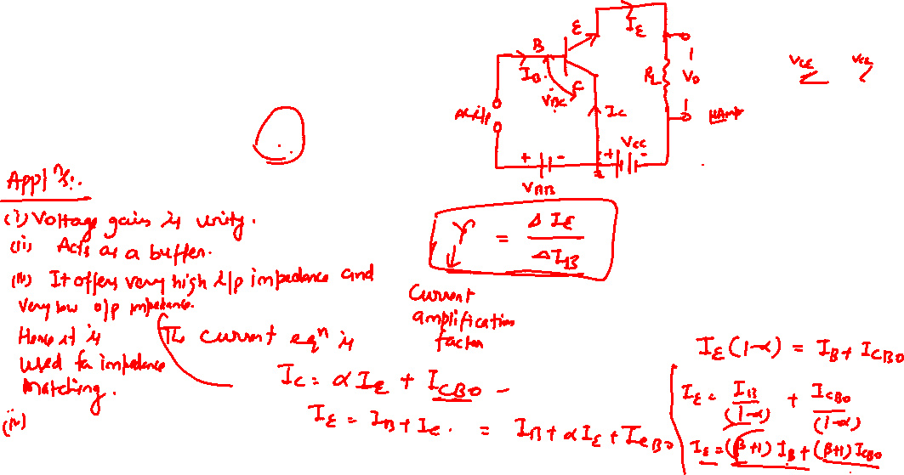
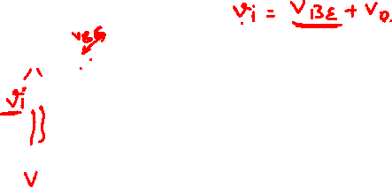
The Common Collector (CC) Configuration

Slide 25
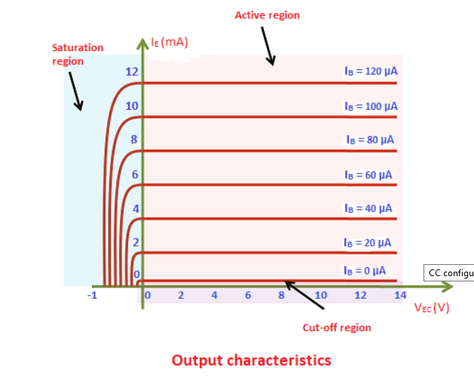

The Common Collector (CC) Configuration

Slide 26




Comparison of CB, CE and CC Configureations

